Slide 1


- TOPIC -
CUSTOMER CHURN PREDICTION & RETENTION STRATEGY
Presented By-
Name : Suyash Kadu
ID : #21395
Mail ID : Suyashkadu11@gmail.com

Slide 2



PROBLEM STATEMENT
Vodafone wants to analyze its customer churn records and develop a retention strategy. They aim to perform customer churn prediction by analyzing factors such as customer location, internet service type, contract type, and payment method.
OBJECTIVES
Identify Key Drivers: To determine the critical factors (e.g., contract type, tenure, payment method, location) that are most strongly correlated with customers deciding to churn.
Profile High-Risk Customers: To create a clear profile of customers most likely to churn (e.g., Month-to-month contract holders with short tenure who pay via Electronic Check).
Provide Actionable Insights: To translate the data findings into specific, data-backed retention strategies and recommendations for Vodafone's marketing and operations teams.
Data Visualization: To build a comprehensive, interactive Tableau Dashboard that allows management to monitor churn trends and filter performance by location, contract, and demographic.

Slide 3
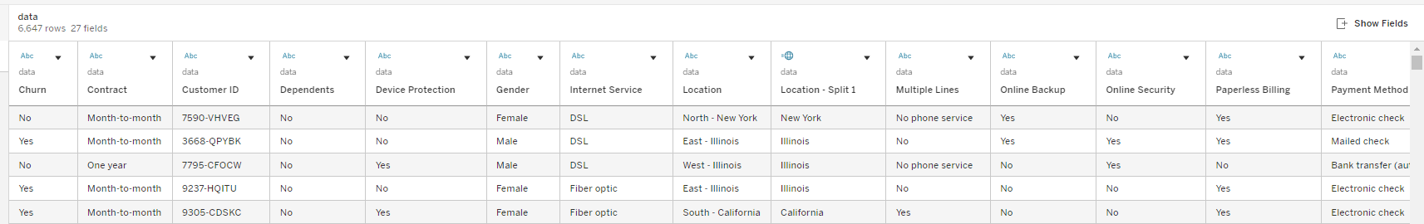
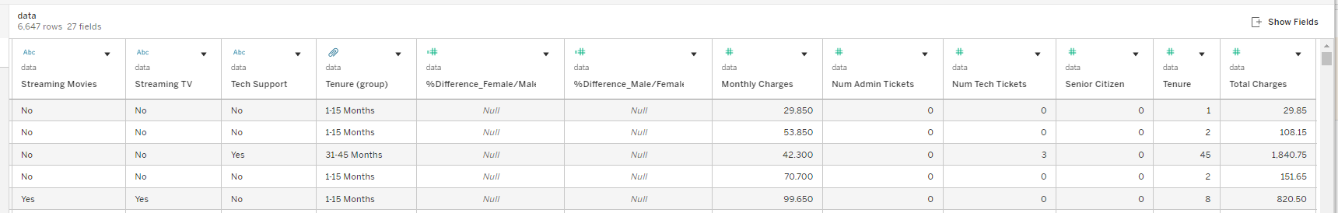
DATASET OVERVIEW
This analysis is based on a sample of 7,043 customer records from a telecom provider (Vodafone), We utilize key variables such as the Contract Type, Customer Tenure (time with the company), and Payment Method to identify strong correlations with the outcome variable of Churn.

Slide 4
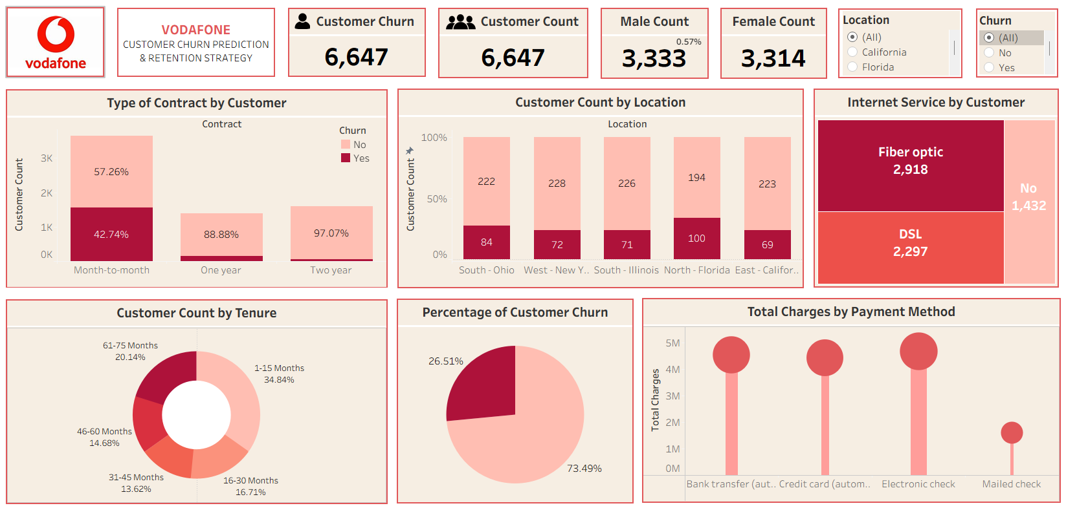
DASHBOARD OVERVIEW

Slide 5
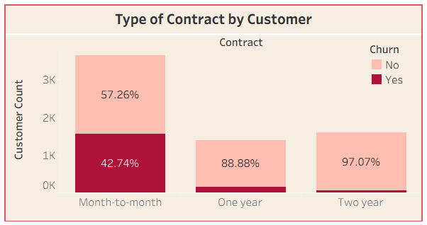
KEY FINDING
1. Month-to-month contract subscribers have a very high likelihood of churning while longer-term contracts have more customer loyalty.
42.74 % of customers on a Month-to-month contract churned.
Whereas only 11.12% of customers on a One Year contract and 2.93% on a Two-Year contract churned within their group

Slide 6
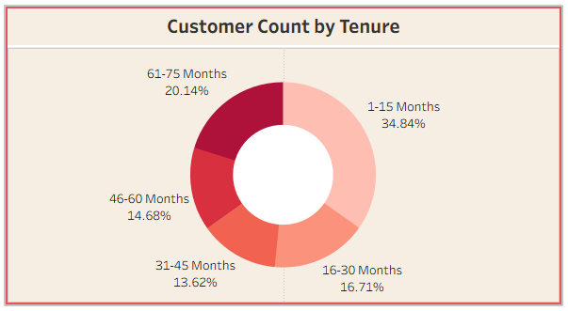
KEY FINDINGS
2. Customers are most likely to leave very early in their relationship highlighting a major issue with onboarding or initial service satisfaction.
The 1-15 Months tenure group is the largest segment and shows the highest overall churn volume of around 38.84%
As tenure increases, the segment size and the proportional churn risk significantly decrease.

Slide 7
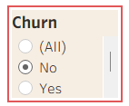
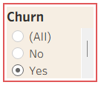
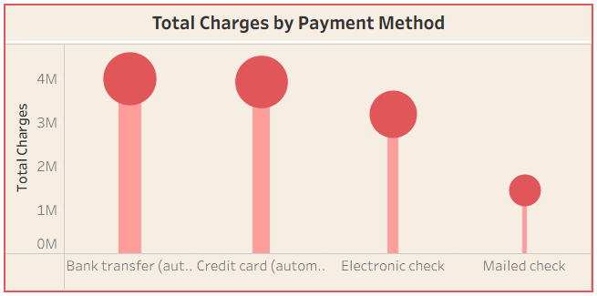
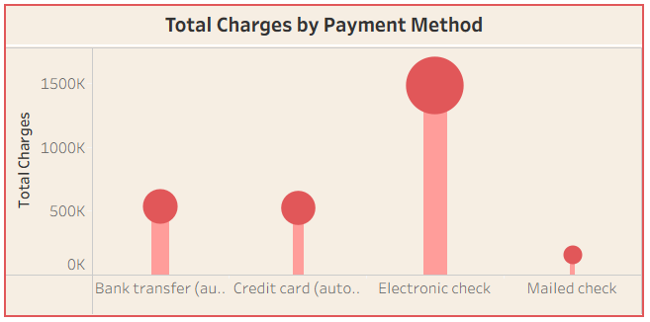
KEY FINDINGS
3. The Electronic Check payment method is strongly associated with churn volume. Whereas those who are using Bank Transfer (Automatic) payment method continued the service.

Slide 8
CONCLUSION
Customers who are not tied down will leave. People on flexible, month-to-month plans and new customers (under 15 months) are the most likely to walk away because they have no long-term commitment.
we are losing customers right at the start. Our focus needs to be on building loyalty early, in the first year of service, rather than just reacting when they try to leave.
While churn is happening everywhere, the customers who pay with Electronic Check are associated with the largest total revenue. If we can keep this specific group from churning, we will save the most money.

Slide 9
- TOPIC -
CUSTOMER CHURN PREDICTION & RETENTION STRATEGY
THANK YOU
Presented By-
Name : Suyash Kadu
ID : #21395
Mail ID : Suyashkadu11@gmail.com

